Slide 1
CSE 405
I/O Interfacing
Osama Hosameldeen
Spring 2021
Lecture 5: ADC and DAC

Slide 2
General Computerized DAQ (DAS) System
Sensors
Signal
Conditioning
A/D
Conversion
Computer
D/A
Conversion
Feedback

Slide 3
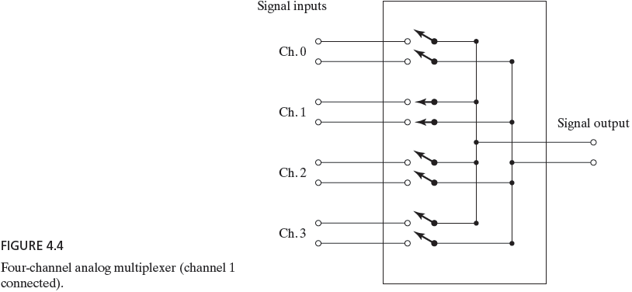
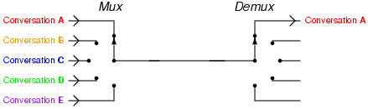
Multiplexer
A multiplexer or MUX is a device that performs multiplexing: it selects one of many analog or digital data sources and outputs that source into a single channel.
A demultiplexer (or DEMUX) is a device taking a single input that selects one of many data-output-lines and connects the single input to the selected output line. A multiplexer is often used with a complementary demultiplexer on the receiving end.
Multiplexer

Slide 4
What is Analog-to-Digital
Conversion (ADC)?
The real world is analog, but computers are digital
ADC converts analog information to digital information
Analog signals contain an infinite amount of data
ADC samples the data and splits it into finite information.

Slide 5
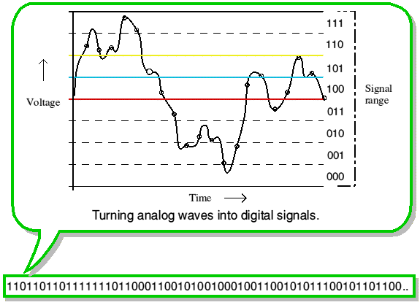
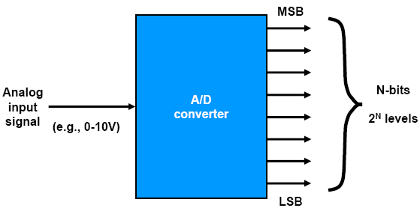
Basics of Analog-to-Digital Conversion
An A/D (or ADC) converts an analog voltage to a digital number through the process of quantization.
The digital number represents the input voltage in discrete steps with finite resolution.
ADC resolution is determined by the number of bits that represent the digital number.
For example, an 8-bit converter with a full-scale voltage of 10V will give you a resolution of 10V/256 which is 39.1 mV.

Slide 6
Basics of Analog-to-Digital Conversion
Terminology
analog: continuously valued signal, such as temperature or speed, with infinite possible values in between
digital: discretely valued signal, such as integers, encoded in binary
analog-to-digital converter: A/D, ADC, A2D; converts an analog signal to a digital signal
digital-to-analog converter: D/A, DAC, D2A

Slide 7
Basics of Analog-to-Digital
Conversion
In general, the output of an analog-to-digital converter has 2^{N} possible values. N: number of bits used to represent the digital output.
The 1-bit device has two possible output states, 0 and 1;
The 2-bit device has possible output states (00, 01, 10, and 11 in binary representation).
Computerized data-acquisition systems usually use A/D converters with at least 8 bits, where the number of possible states is 256.
The possible states are then represented by binary numbers with values between 00000000 and 11111111. For example of an output of 10000001, which represents a number of 129 in decimal.
Notes:
My research experience includes structure mechanics, dynamics and control, and nanomechanics and nanotribology.
The applications ranged from large aircraft structure to smaller mechanical face seal, to miniature system, like computer hard drive head disk interface.
The computer hard drive research and development involved many aspects of nanotechnology, from design, to process, to testing. It is this experience that stimulate my desire to pursue further research in nanotechnology.

Slide 8
Basics of Analog-to-Digital
Conversion
Bits | 1 | 2 | 6 | 8 | 10 | 12
2^{N} = | 2 | 4 | 64 | 256 | 1024 | 4096
Characteristics
  N determines the resolution of the output
  The greater the number of bits, the greater the number of possible output states and the more accurately the digital output will represent the analog input
  Input range: unipolar and bipolar
    A unipolar converter can only respond to analog inputs with the same sign
  A bipolar converter can convert both positive and negative analog inputs
  Conversion speed: the time it takes to create a digital output after the device is instructed to make a conversion.
Notes:
The applications ranged from large aircraft structure to smaller mechanical face seal, to miniature system, like computer hard drive head disk interface.

Slide 9
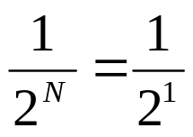
1-bit Analog-to-Digital Conversion
A comparator is the most basic ADC
This is a 1-bit Flash ADC
V_{in}
C
Out
1 Volt
V_{ref}
Comparator
1
V_{ref} =. 5 V
Out = 0 if V_{in} < V_{ref}
  = 1 if V_{in} > V_{ref}
0
0 Volt
Increment =
(resolution)
= 0.5 V
V_{in}
V_{Out}

Slide 10
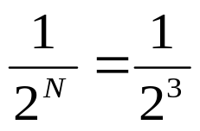
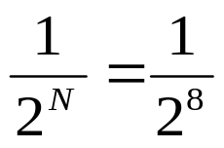
3-bit Analog-to-Digital Conversion
N-bit
Digital Output
Analog
Input
N-bit
ADC
3-bit ADC Scale
1 Volt
111
. 875
110
. 75 Volt
101
. 625
100
. 5 V
Increment =
(resolution)
= 0.125 V
011
. 375
010
. 25 V
001
. 125
000
0 Volt
Analog Input Signal
Digital Output Code
Increment =
(resolution)
= 0.0391 V
Data Range 0-10 volts
256 distinct possible values
8-bit ADC

Slide 11
4-bit Analog-to-Digital Conversion
V_{max} = 7.5V
1111
4
4
7.0V
1110
6.5V
1101
3
3
6.0V
1100
5.5V
1011
2
2
5.0V
1010
analog input (V)
analog output (V)
4.5V
1001
1
1
4.0V
1000
3.5V
0111
3.0V
0110
t1
t2
t3
time
t1
t2
t3
t4
time
2.5V
0101
t4
2.0V
0100
0100
1000
0110
0101
0100
1000
0110
0101
1.5V
0011
Digital output
Digital input
1.0V
0010
0.5V
0001
0V
0000
proportionality
analog to digital
digital to analog

Slide 12
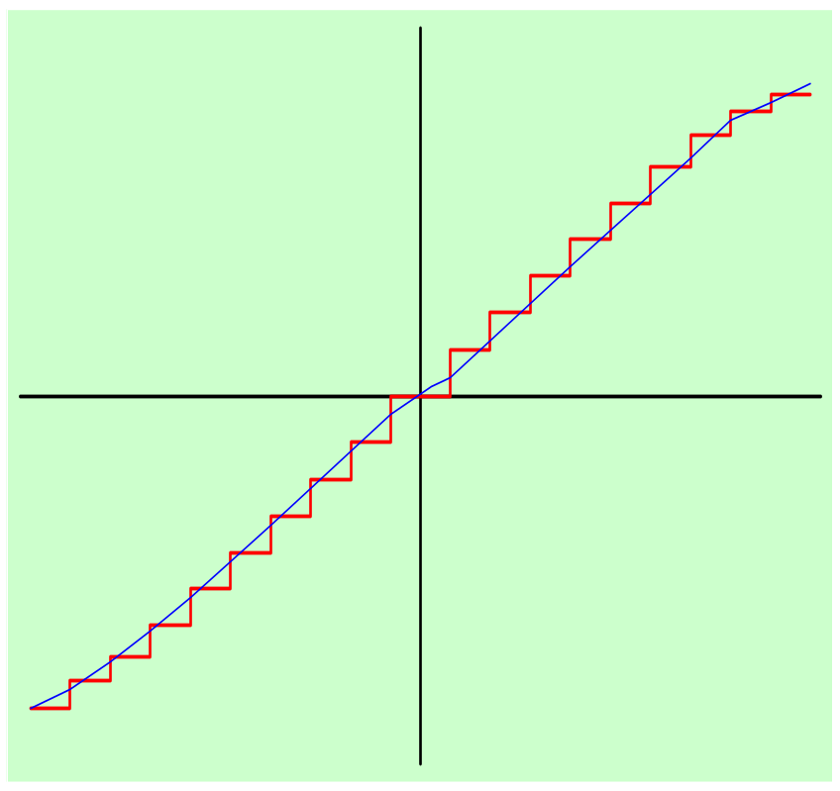
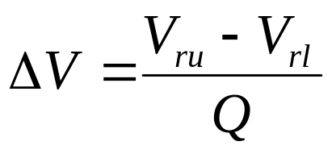
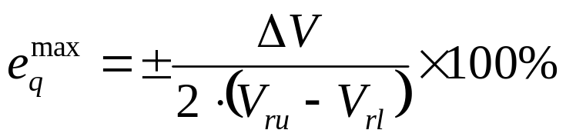
A/D Conversion Basics: Quantization
Quantization is to convert the input voltage range into Q=2^{N} bands to encode a continuous analog signal to discrete digital levels.
Volt
Quantization Interval:
Time
Quantization Error:

Slide 13
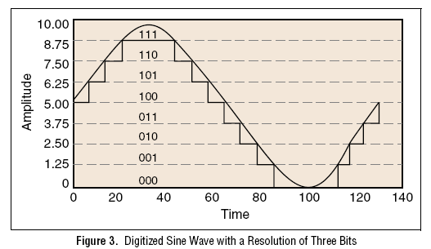
A/D Conversion Basics: Quantization
saturation error
Quantization error
Notes:
My research experience includes structure mechanics, dynamics and control, and nanomechanics and nanotribology.
The applications ranged from large aircraft structure to smaller mechanical face seal, to miniature system, like computer hard drive head disk interface.
The computer hard drive research and development involved many aspects of nanotechnology, from design, to process, to testing. It is this experience that stimulate my desire to pursue further research in nanotechnology.

Slide 14
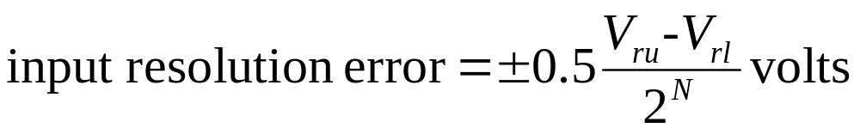
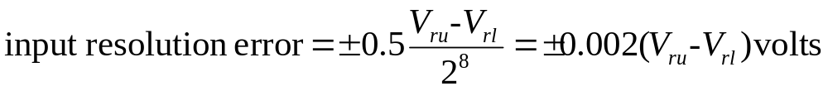
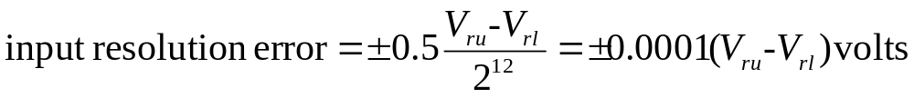
A/D Conversion Basics: Resolution
Related to input range, typically
  Lowest bit determines resolution
Resolution: smallest analog change resulting from changing one bit
Since the output of an A/D converter changes in discrete steps, there is a resolution error (uncertainty), known as a quantization error.
The quantization error is ±0.5 LSB. In input units, this is expressed as
For an 8-bit converter
For a 12-bit converter

Slide 15
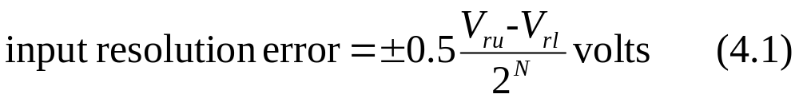
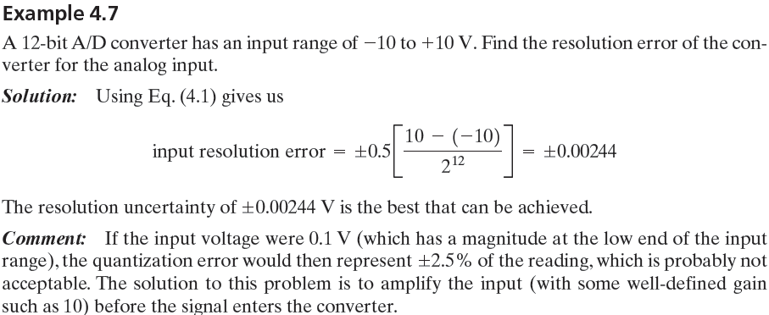
A/D Conversion Basics: Resolution
In general, the primary sources of error in any A/D converter are:
  Resolution and associated quantization error: This error is associated with the conversion of a range of analog voltage into a binary output.
  Saturation error: This error occurs if the voltage exceeds the minimum and maximum voltage limits.
  Conversion error: This error is associated with the measurement device errors.

Slide 16
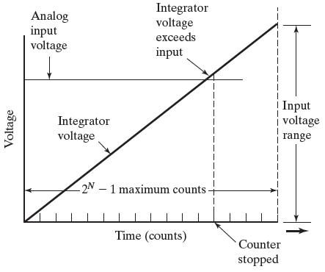
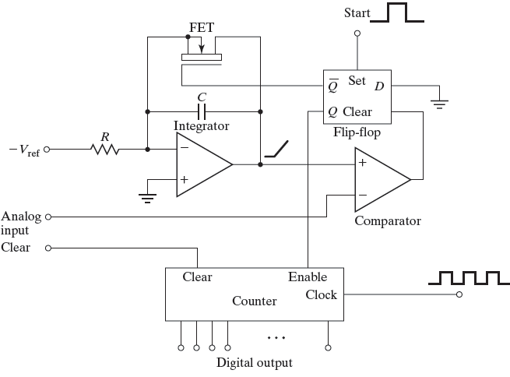
A/D Types and Conversion Process
There many different types of analog-to-digital converters (ADC) available for DAQ systems. Different ADC types offer varying resolution, accuracy, and speed specifications
The most popular ADC types are the parallel (flash) converter, the successive approximation, and the voltage-to-frequency ADCs.
Ramp A/D converter process
Single-slope integrating A/D converter circuit

Slide 17
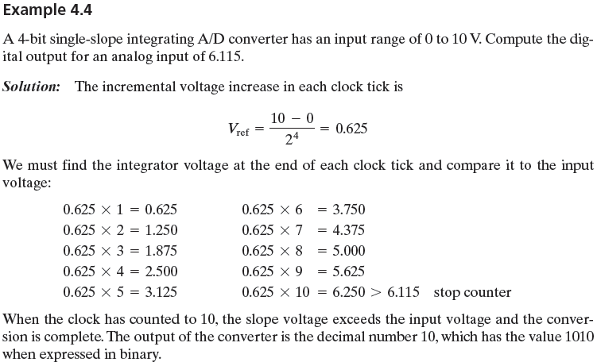
Example of a Simple A/D Converter
Integrator
Comparator
Counter

Slide 18
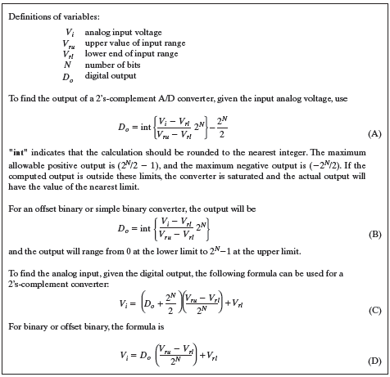
Digital Output of A/D Converters
FIGURE 4.7 Formulas to estimate A/D converter digital output.
Notes:
Offset binary is just like simple binary except that for bipolar converters, the output code of zero corresponds to the lower end of the input range instead of an
input of zero. 2’s complement starts with a binary number on at the lower end of the range, has a value of zero in the center of the input range, and rises to
at the top end of the range.

Slide 19
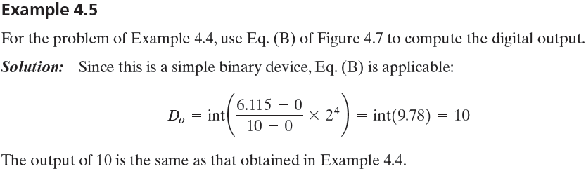
Digital Output of A/D Converters

Slide 20
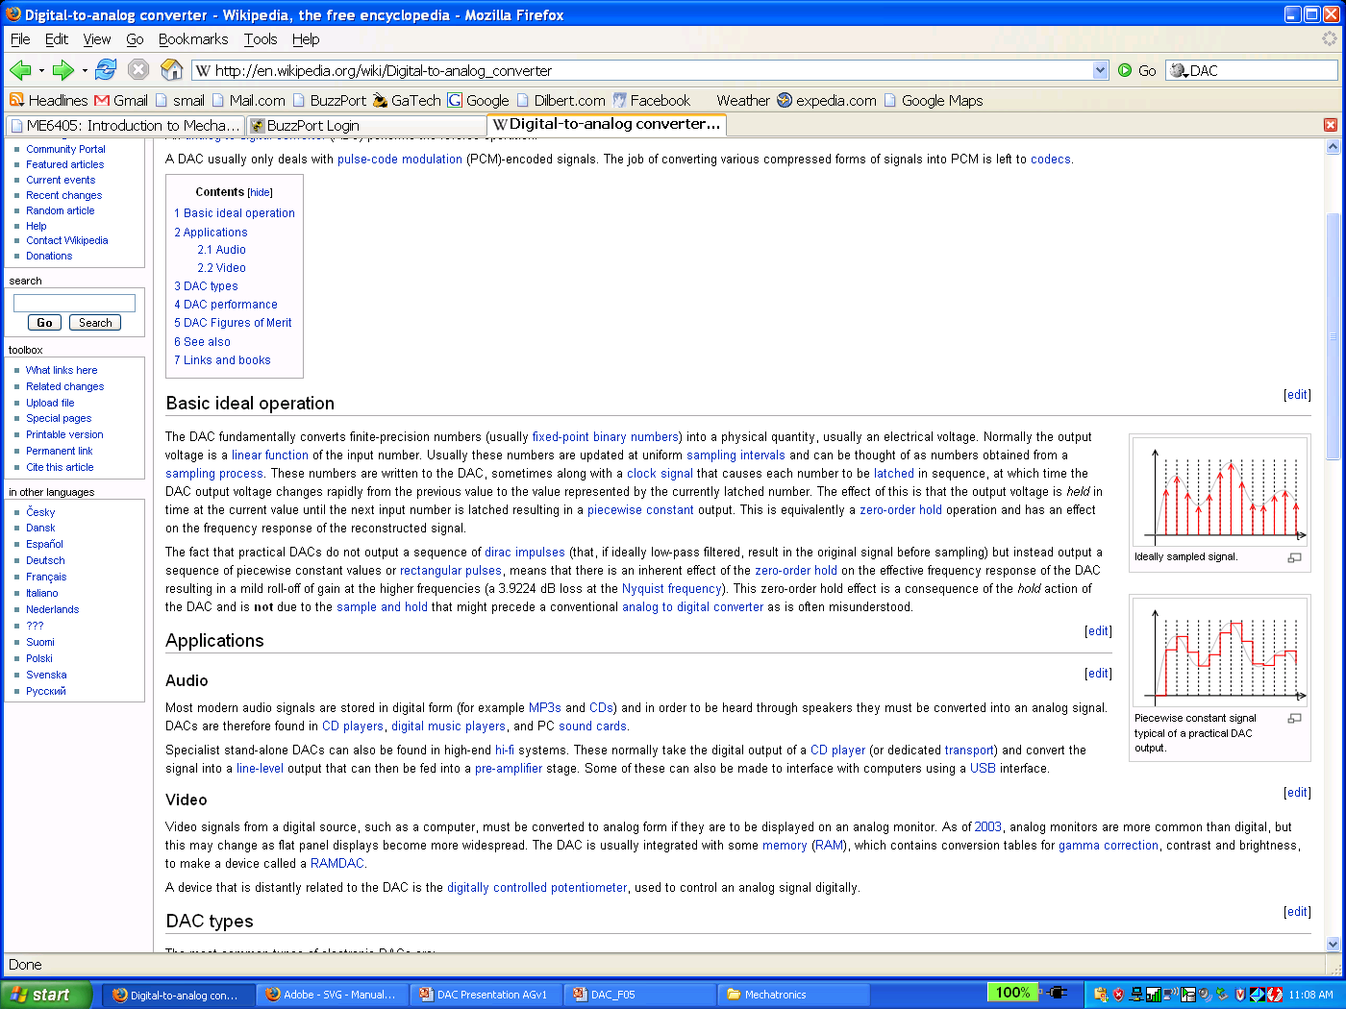
Digital-to-Analog Converters (DAC)
The DAC fundamentally converts finite-precision numbers (usually fixed-point binary numbers) into a physical quantity, usually an electrical voltage. Normally the output voltage is a linear function of the input number.
Usually these numbers are updated at uniform sampling intervals and can be thought of as numbers obtained from a sampling process
Output is a sequence of piecewise constant values or rectangular pulses, means that there is an inherent effect of the zero-order hold on the effective frequency response of the DAC resulting in a mild roll-off of gain at the higher frequencies.
Ideally Sampled Signal
Output typical of a real, practical DAC due to sample & hold

Slide 21
4-bit A/D and D/A Conversion
V_{max} = 7.5V
1111
4
4
7.0V
1110
6.5V
1101
3
3
6.0V
1100
5.5V
1011
2
2
5.0V
1010
analog input (V)
analog output (V)
4.5V
1001
1
1
4.0V
1000
3.5V
0111
3.0V
0110
t1
t2
t3
time
t1
t2
t3
t4
time
2.5V
0101
t4
2.0V
0100
0100
1000
0110
0101
0100
1000
0110
0101
1.5V
0011
Digital output
Digital input
1.0V
0010
0.5V
0001
0V
0000
proportionality
analog to digital
digital to analog

Slide 22
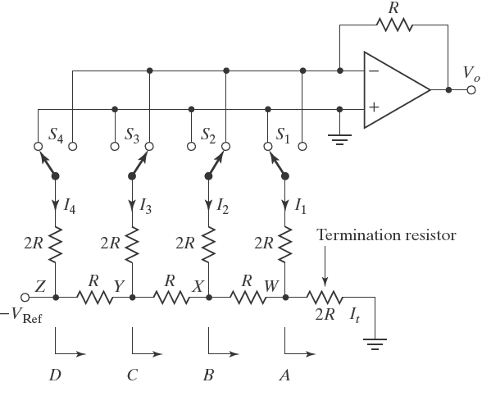
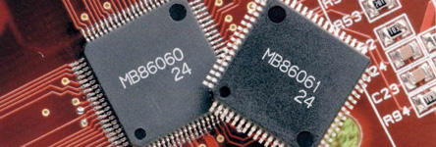
Digital-to-Analog (D/A) Converters
Summing junction
V
=
K
(
S
⋅
2
3
+
S
⋅
2
2
+
S
⋅
2
1
+
S
⋅
2
0
)
o
4
3
2
1
Voltagedivider
digital-to-analog converter (D/A converter or DAC)
In the above DAC, there are four bits and four switches. The resulting analog output voltage will be proportional to the digital input number.

Slide 23
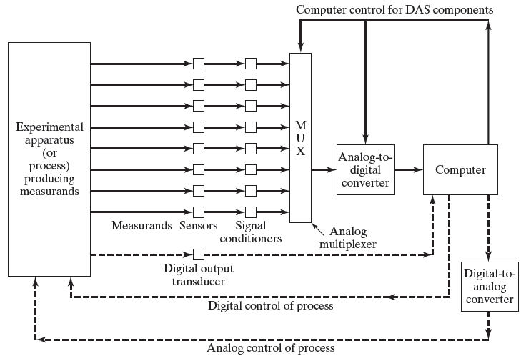
Configuration of Data-Acquisition System

Slide 24
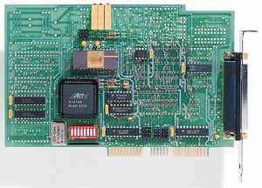
Computer Data Acquisition Board
A plug-in data acquisition board is inserted directly into computer’s bus and transfer data directly to computer’s memory.
It utilizes computer hardware:
  cables & buses
  power supply
  back panel, etc.
It is designed for particular bus structure, and unaffected by computer’s internal electrical noise.
CPU
transfers
to RAM
Display
CPU
retrieves
from RAM
Display
Display

Slide 25
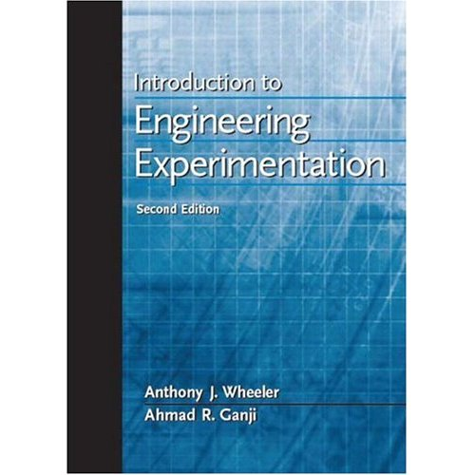
Reference
Introduction to Engineering Experimentation by A.J. Wheeler and A.R. Ganji (2 nd edition), Pearson Prentice Hall, 2004.
https://users.encs.concordia.ca/home/c/cheung/Document%20save/MECH373-MEASUREMENTS/LECTURE/

